Slide 1
Unified Modelling Language
Ramaswamy Krishnan Chittur

Slide 2
Unified Modelling Language (UML)
Visualizes the architecture and design of a software system. After all, a picture speaks a thousand words as they say.
Common types of UML diagrams:
Module diagram
Class diagram
Activity diagram
Reference:
UML 2.5 Diagrams Overview (uml-diagrams.org)
Practical UML: A Hands-On Introduction for Developers (embarcadero.com)
Exercises:
Draw a class diagram that shows the relationship between the following types:
Interface IAutomobile, Class Engine, Class Tyre, Class SnowChain, Class Passenger, and Class Car.

Slide 3
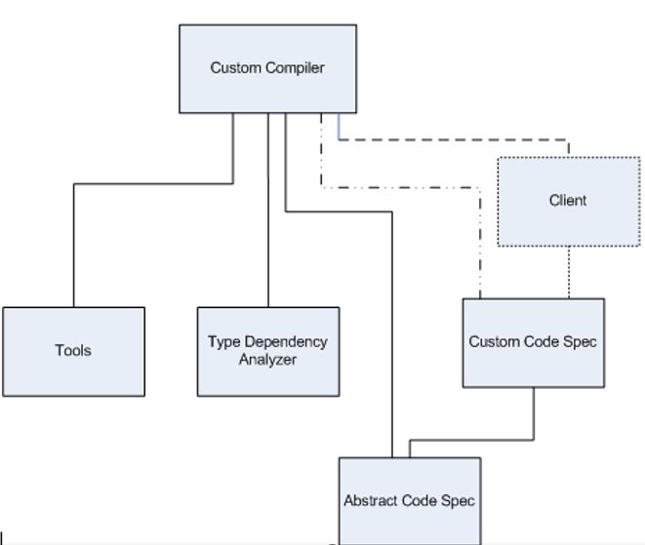
Module diagram
Shows the various modules in the software project, and their dependencies.
No cyclic dependency.
Lower level modules may not depend on upper level modules.
-

Slide 4
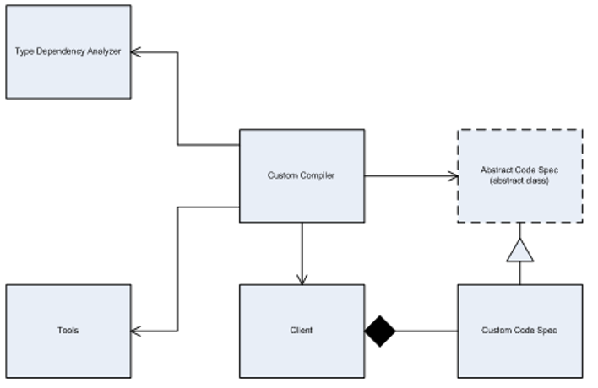
Class diagram
Shows the relationship between the various types in the software project: Composition, Aggregation, Inheritance and Using.
-

Slide 5
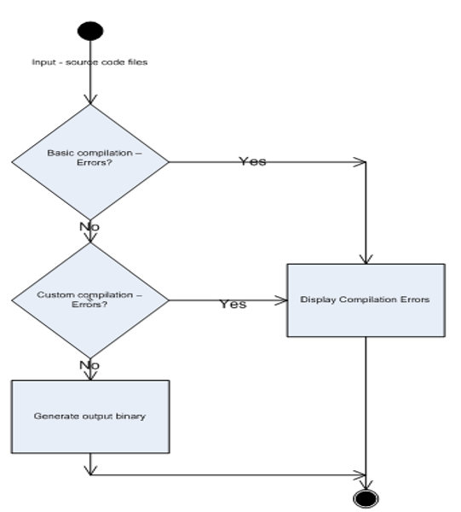
Activity diagram
This is essentially a version of a flow chart that shows the sequence of activities between the various components in the software project.
-

Slide 6
Q & A

